Slide 1
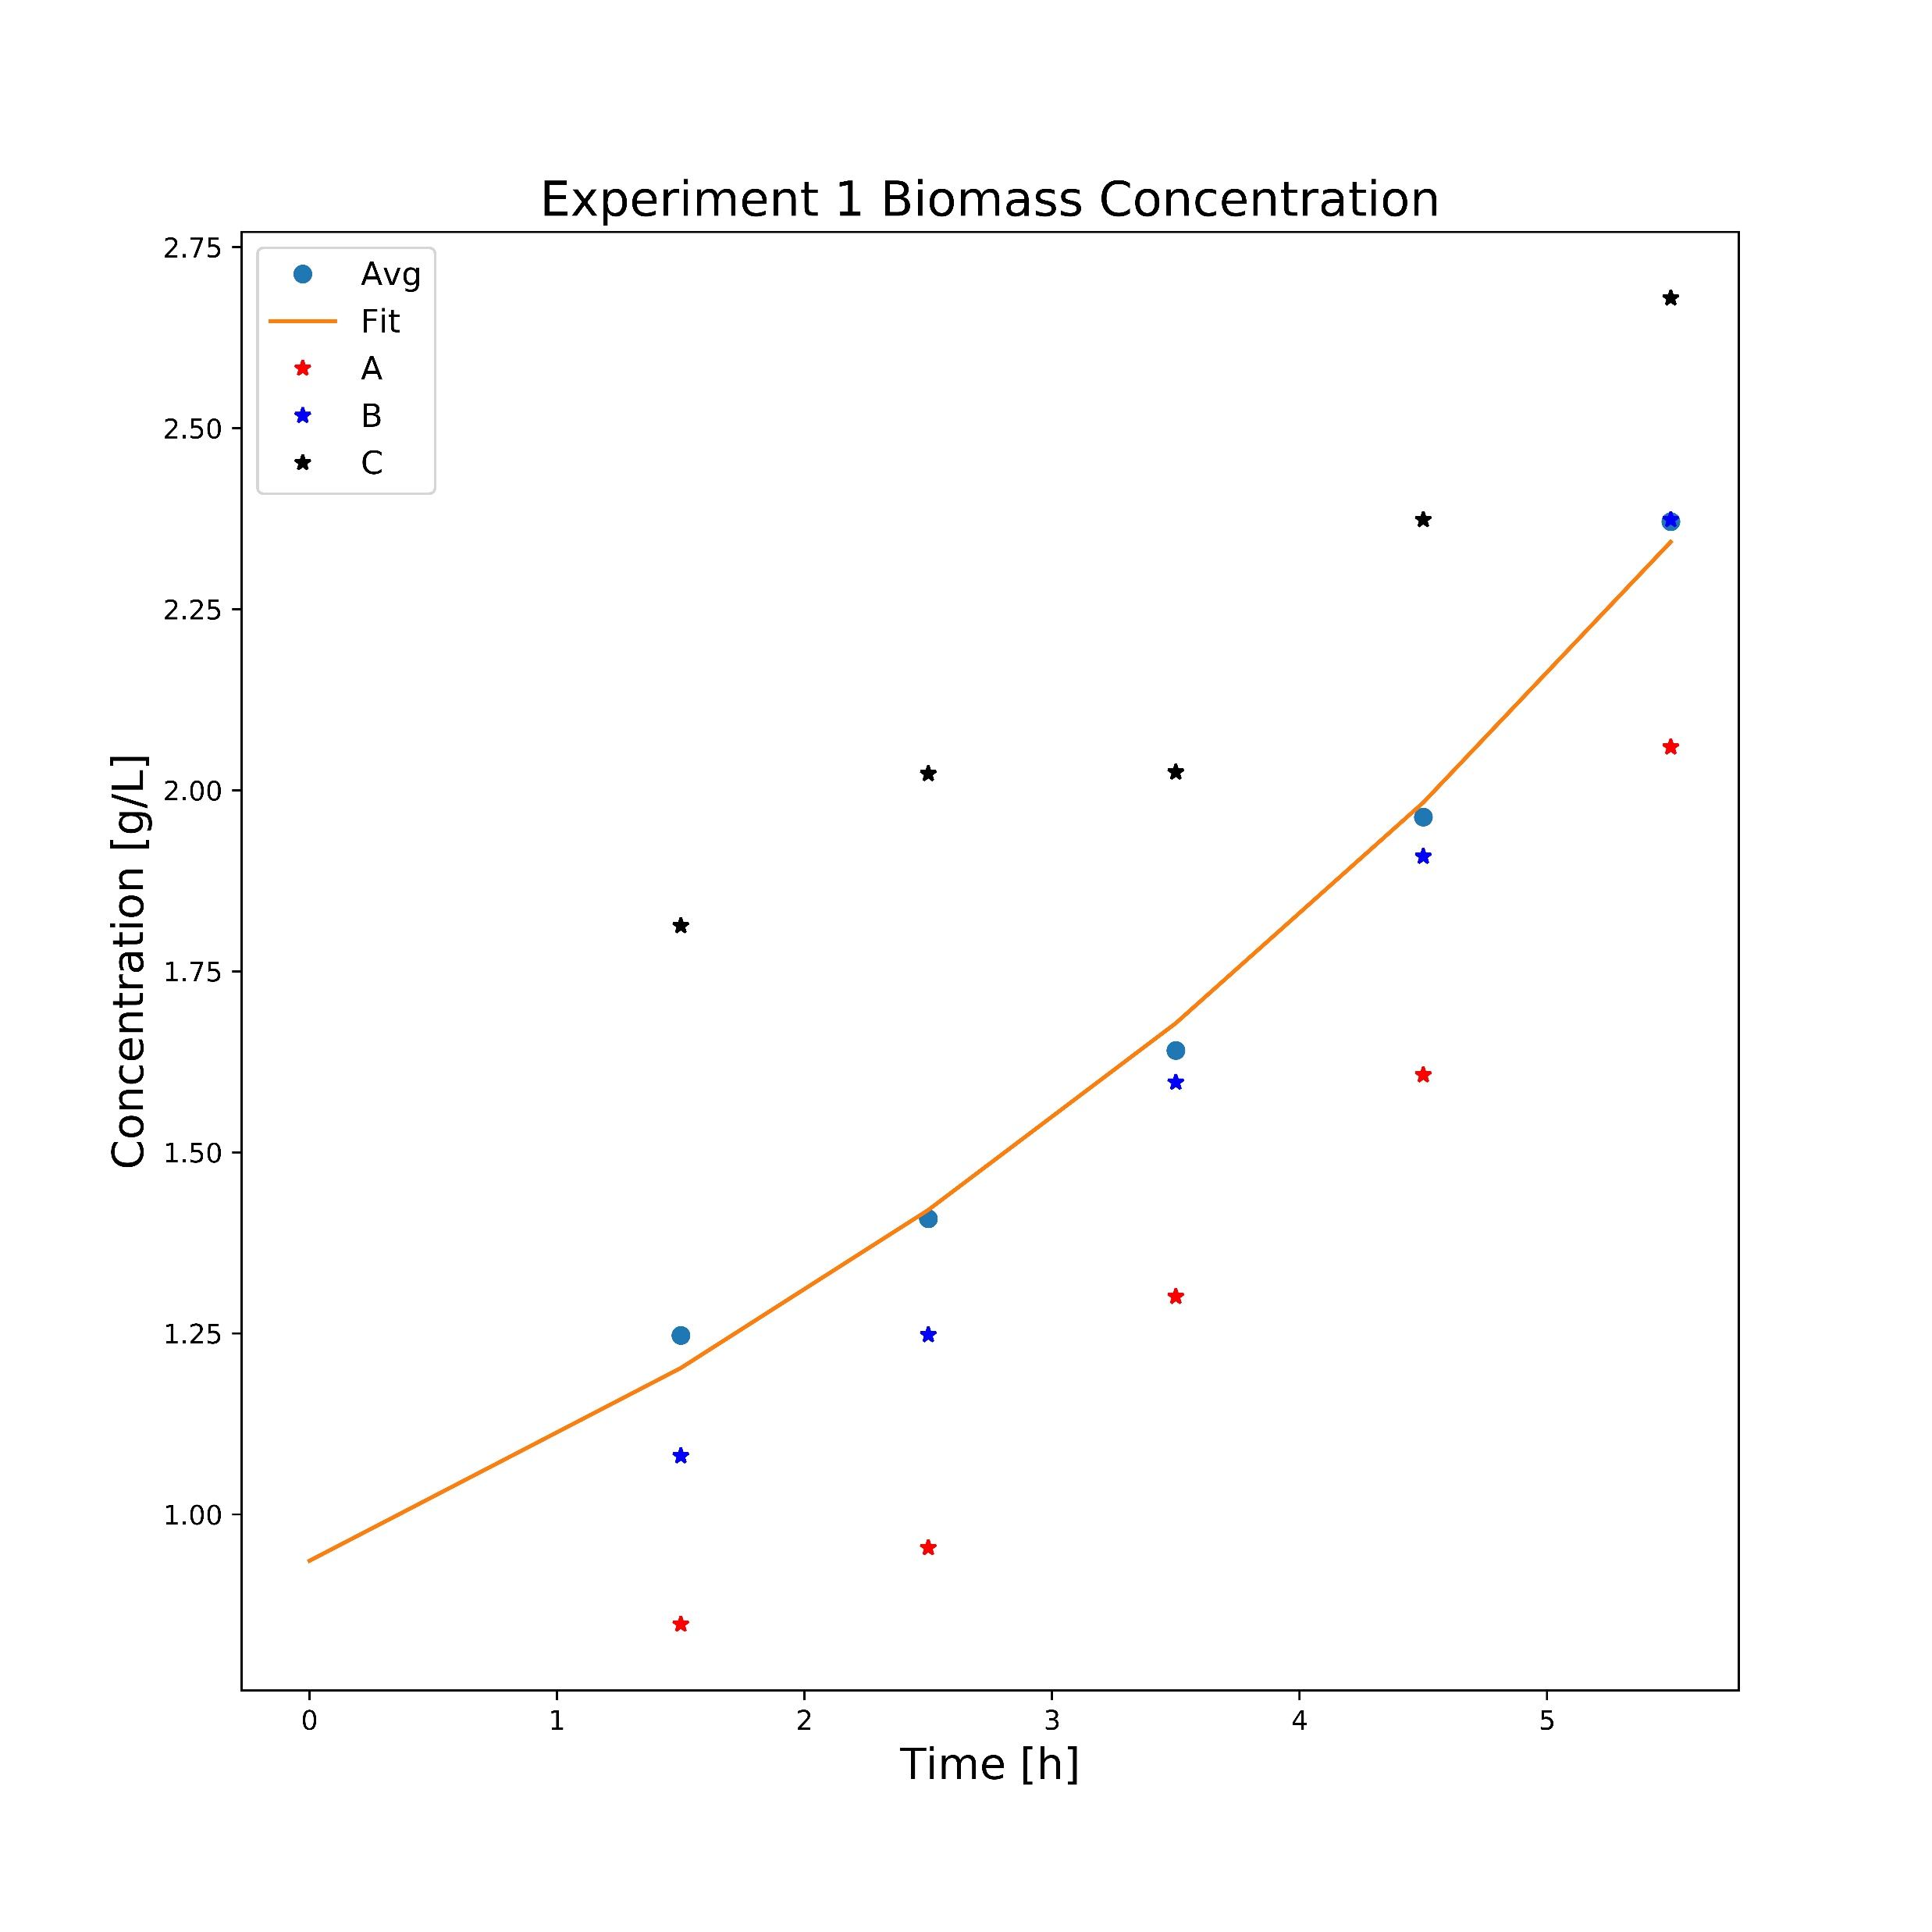
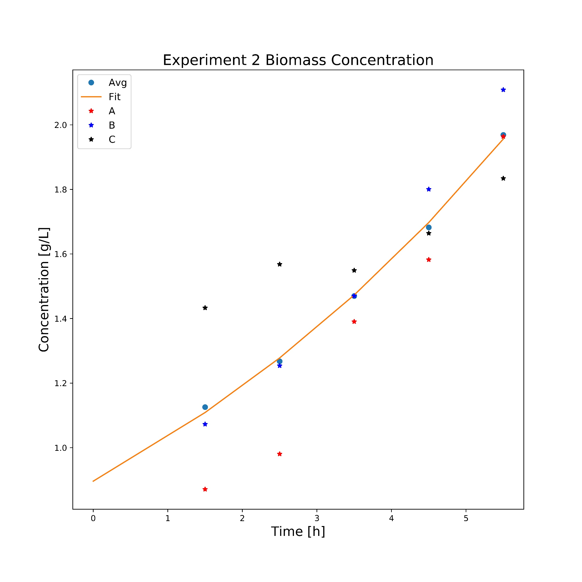
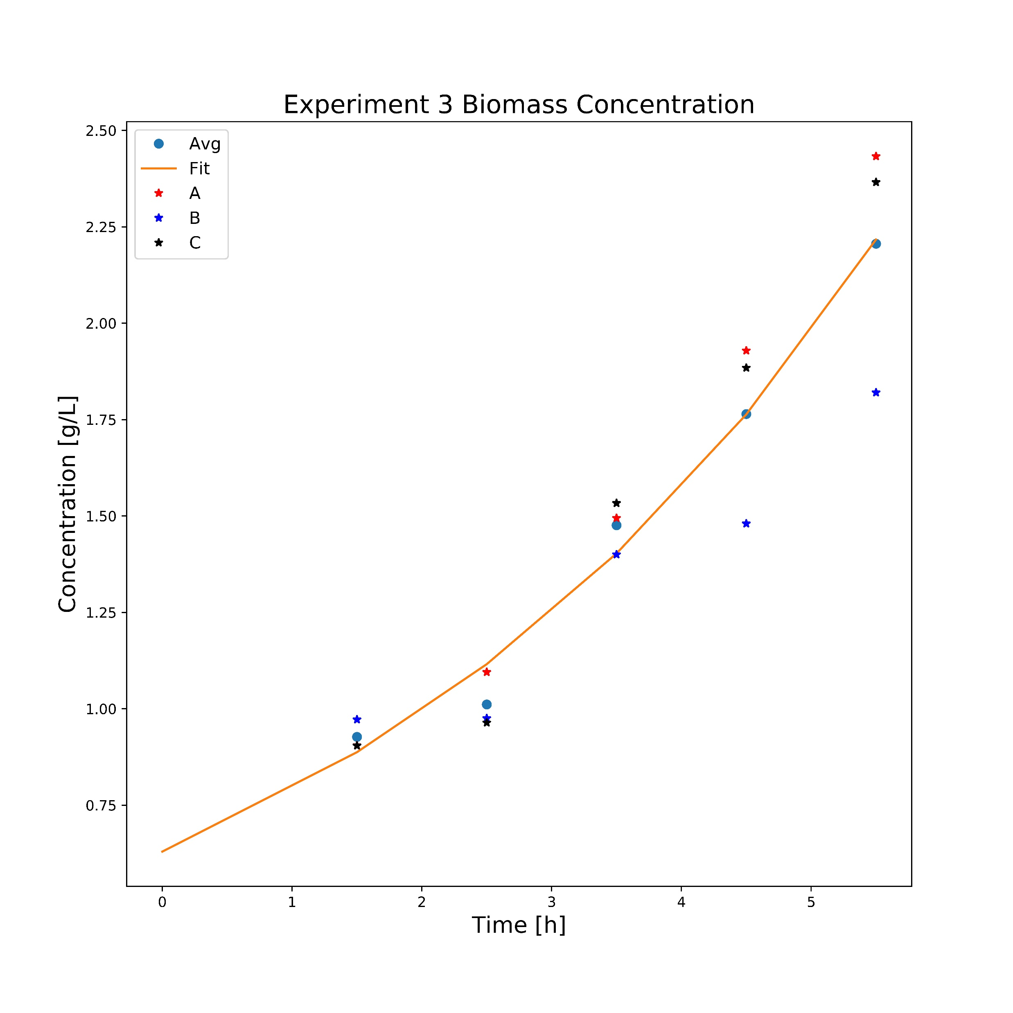
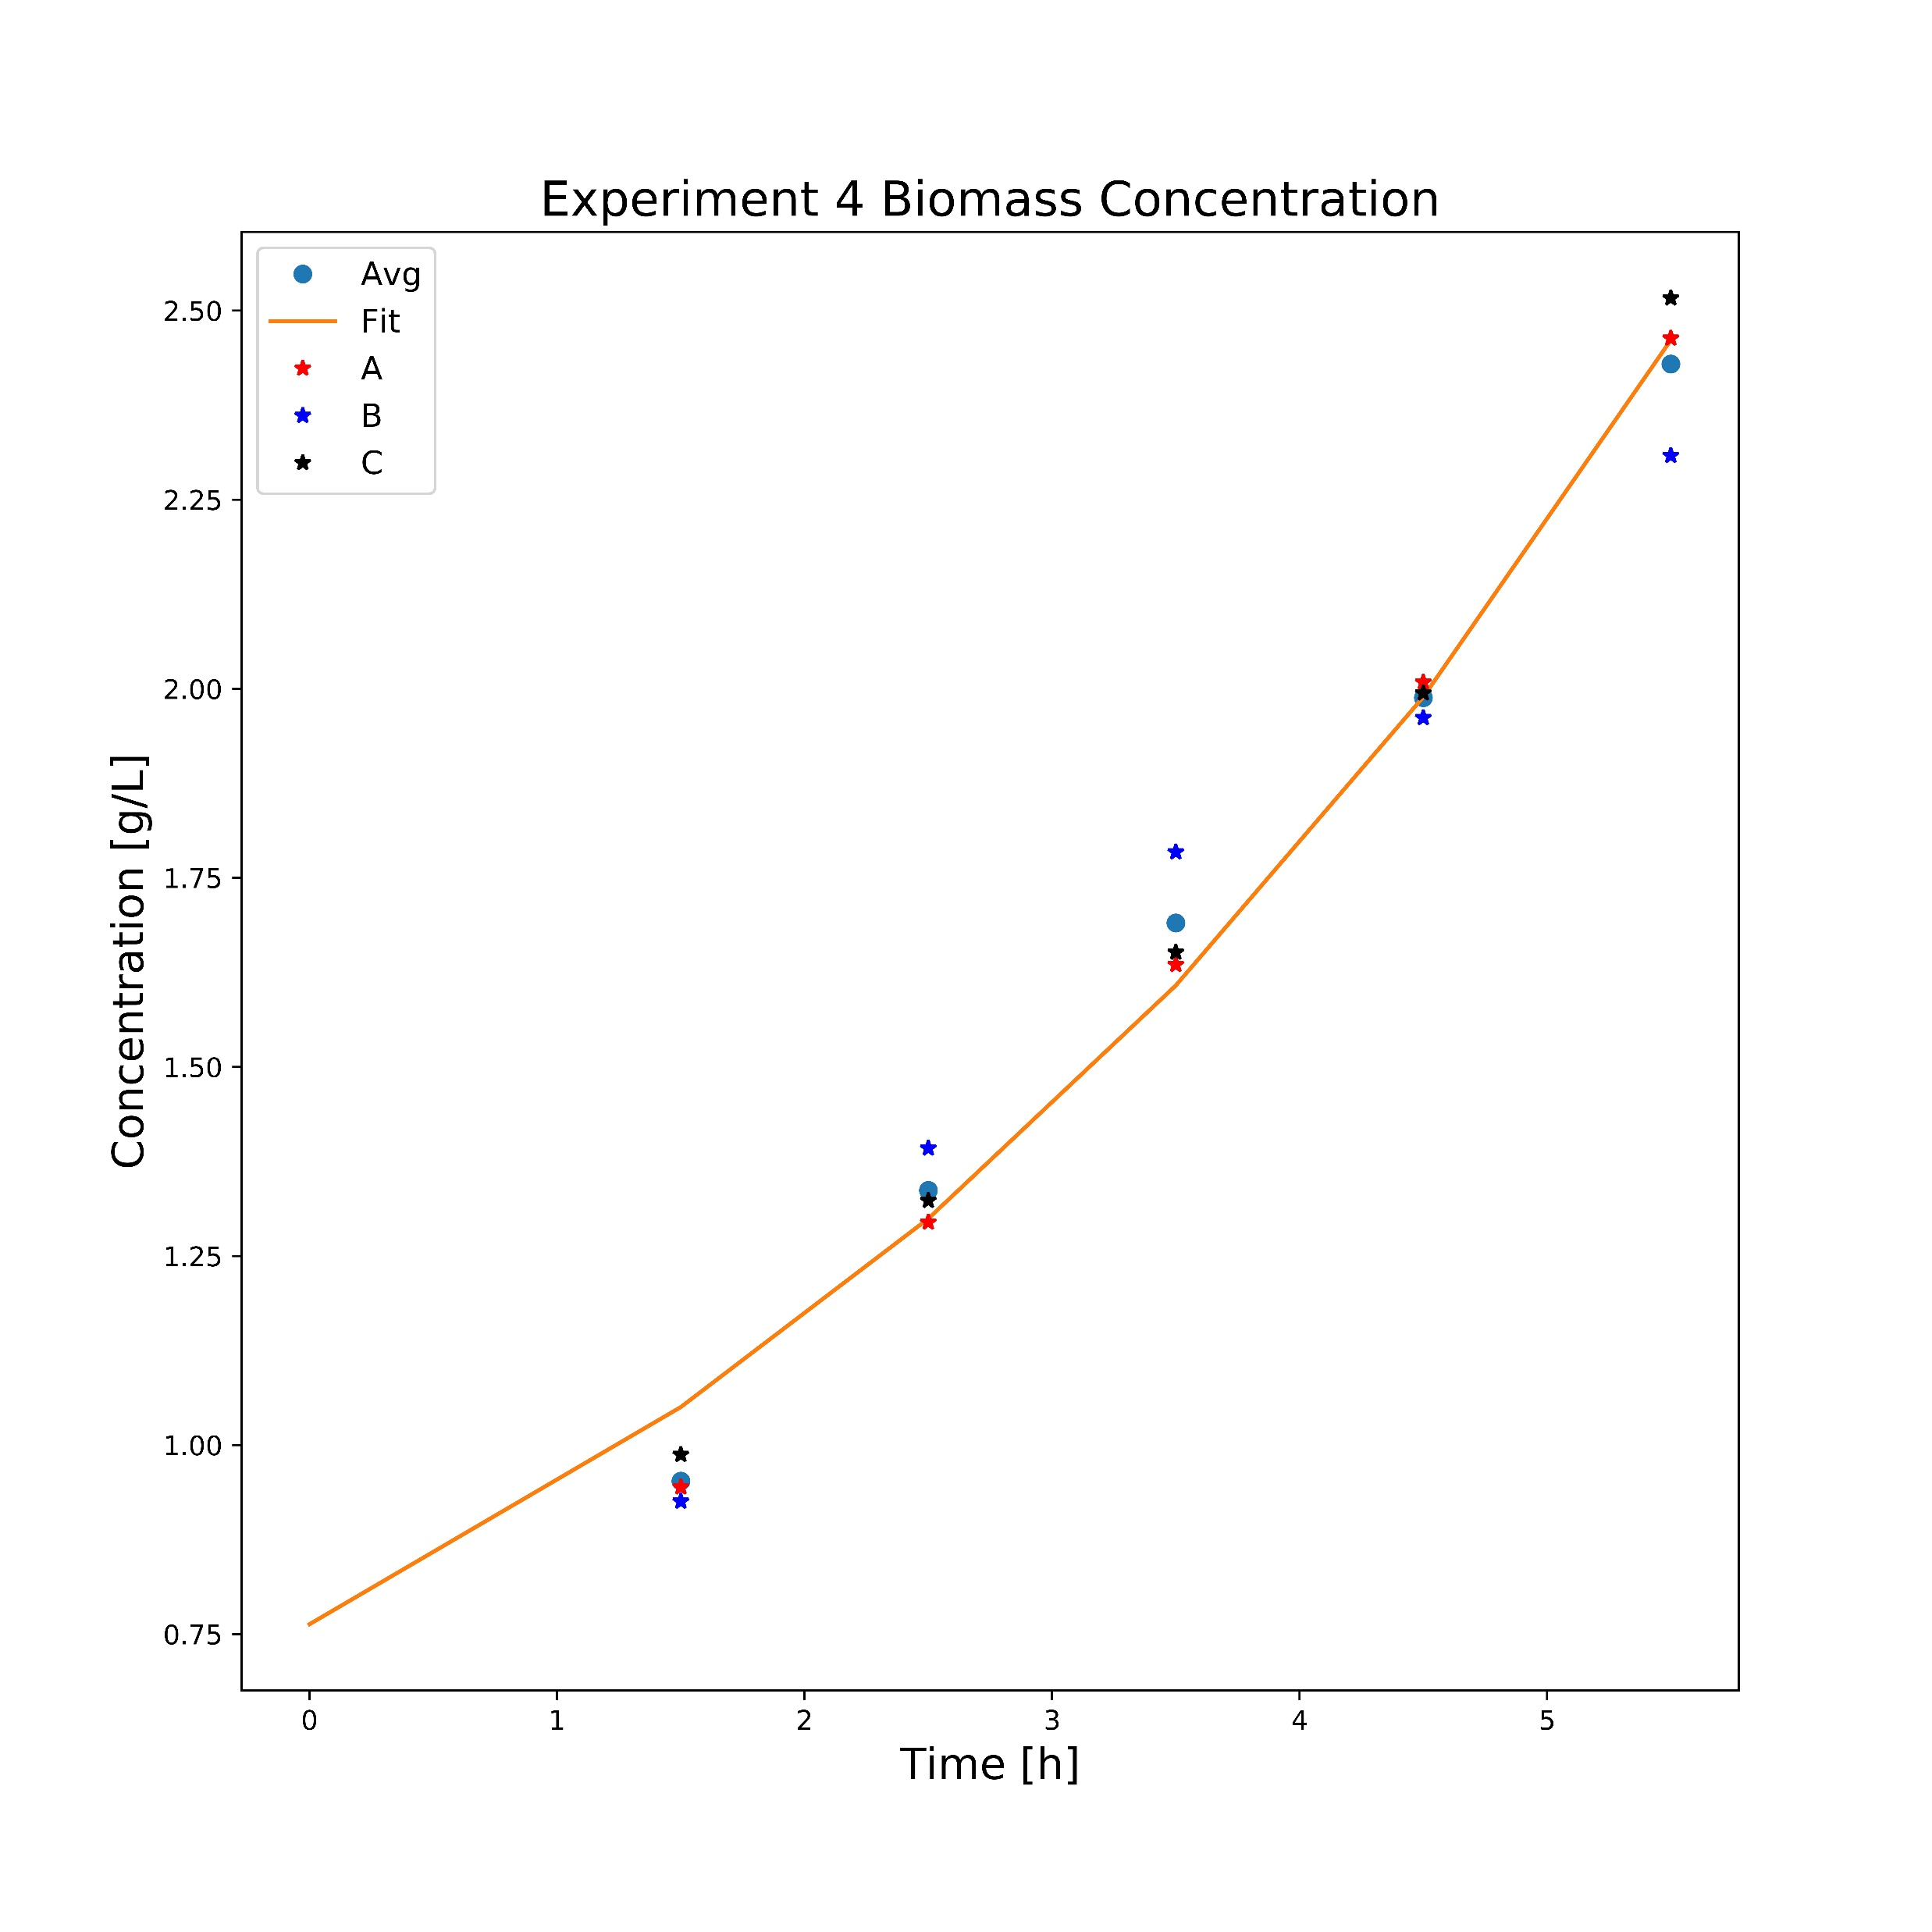
A4
μ For Average Cx:
0,16686
μ For Average Cx:
0,14191
μ For Average Cx:
0,22894
μ For Average Cx:
0,21289
μ For A4 Cx:
0,22

Slide 2
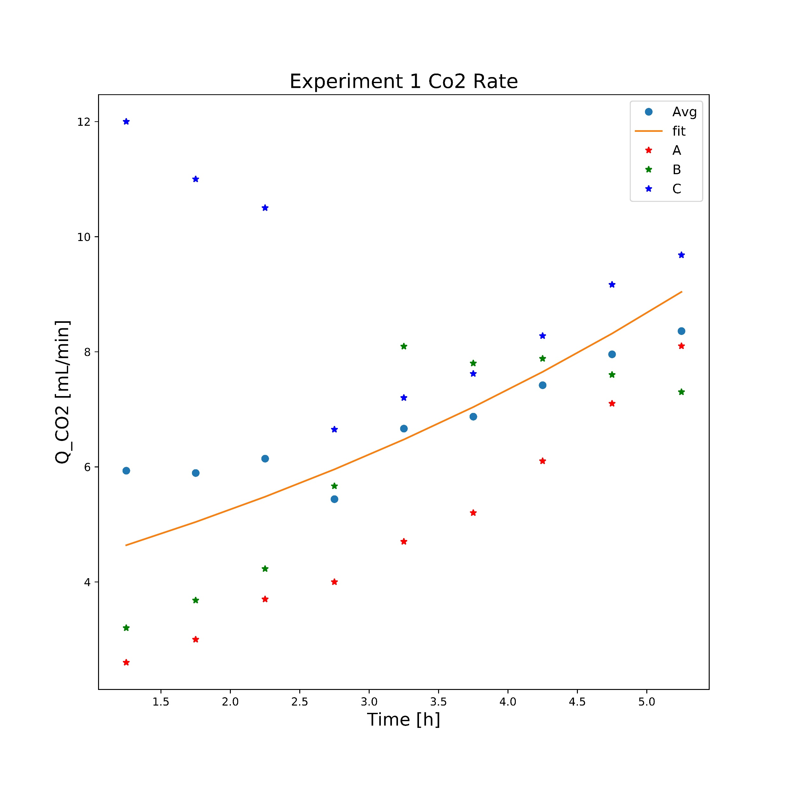
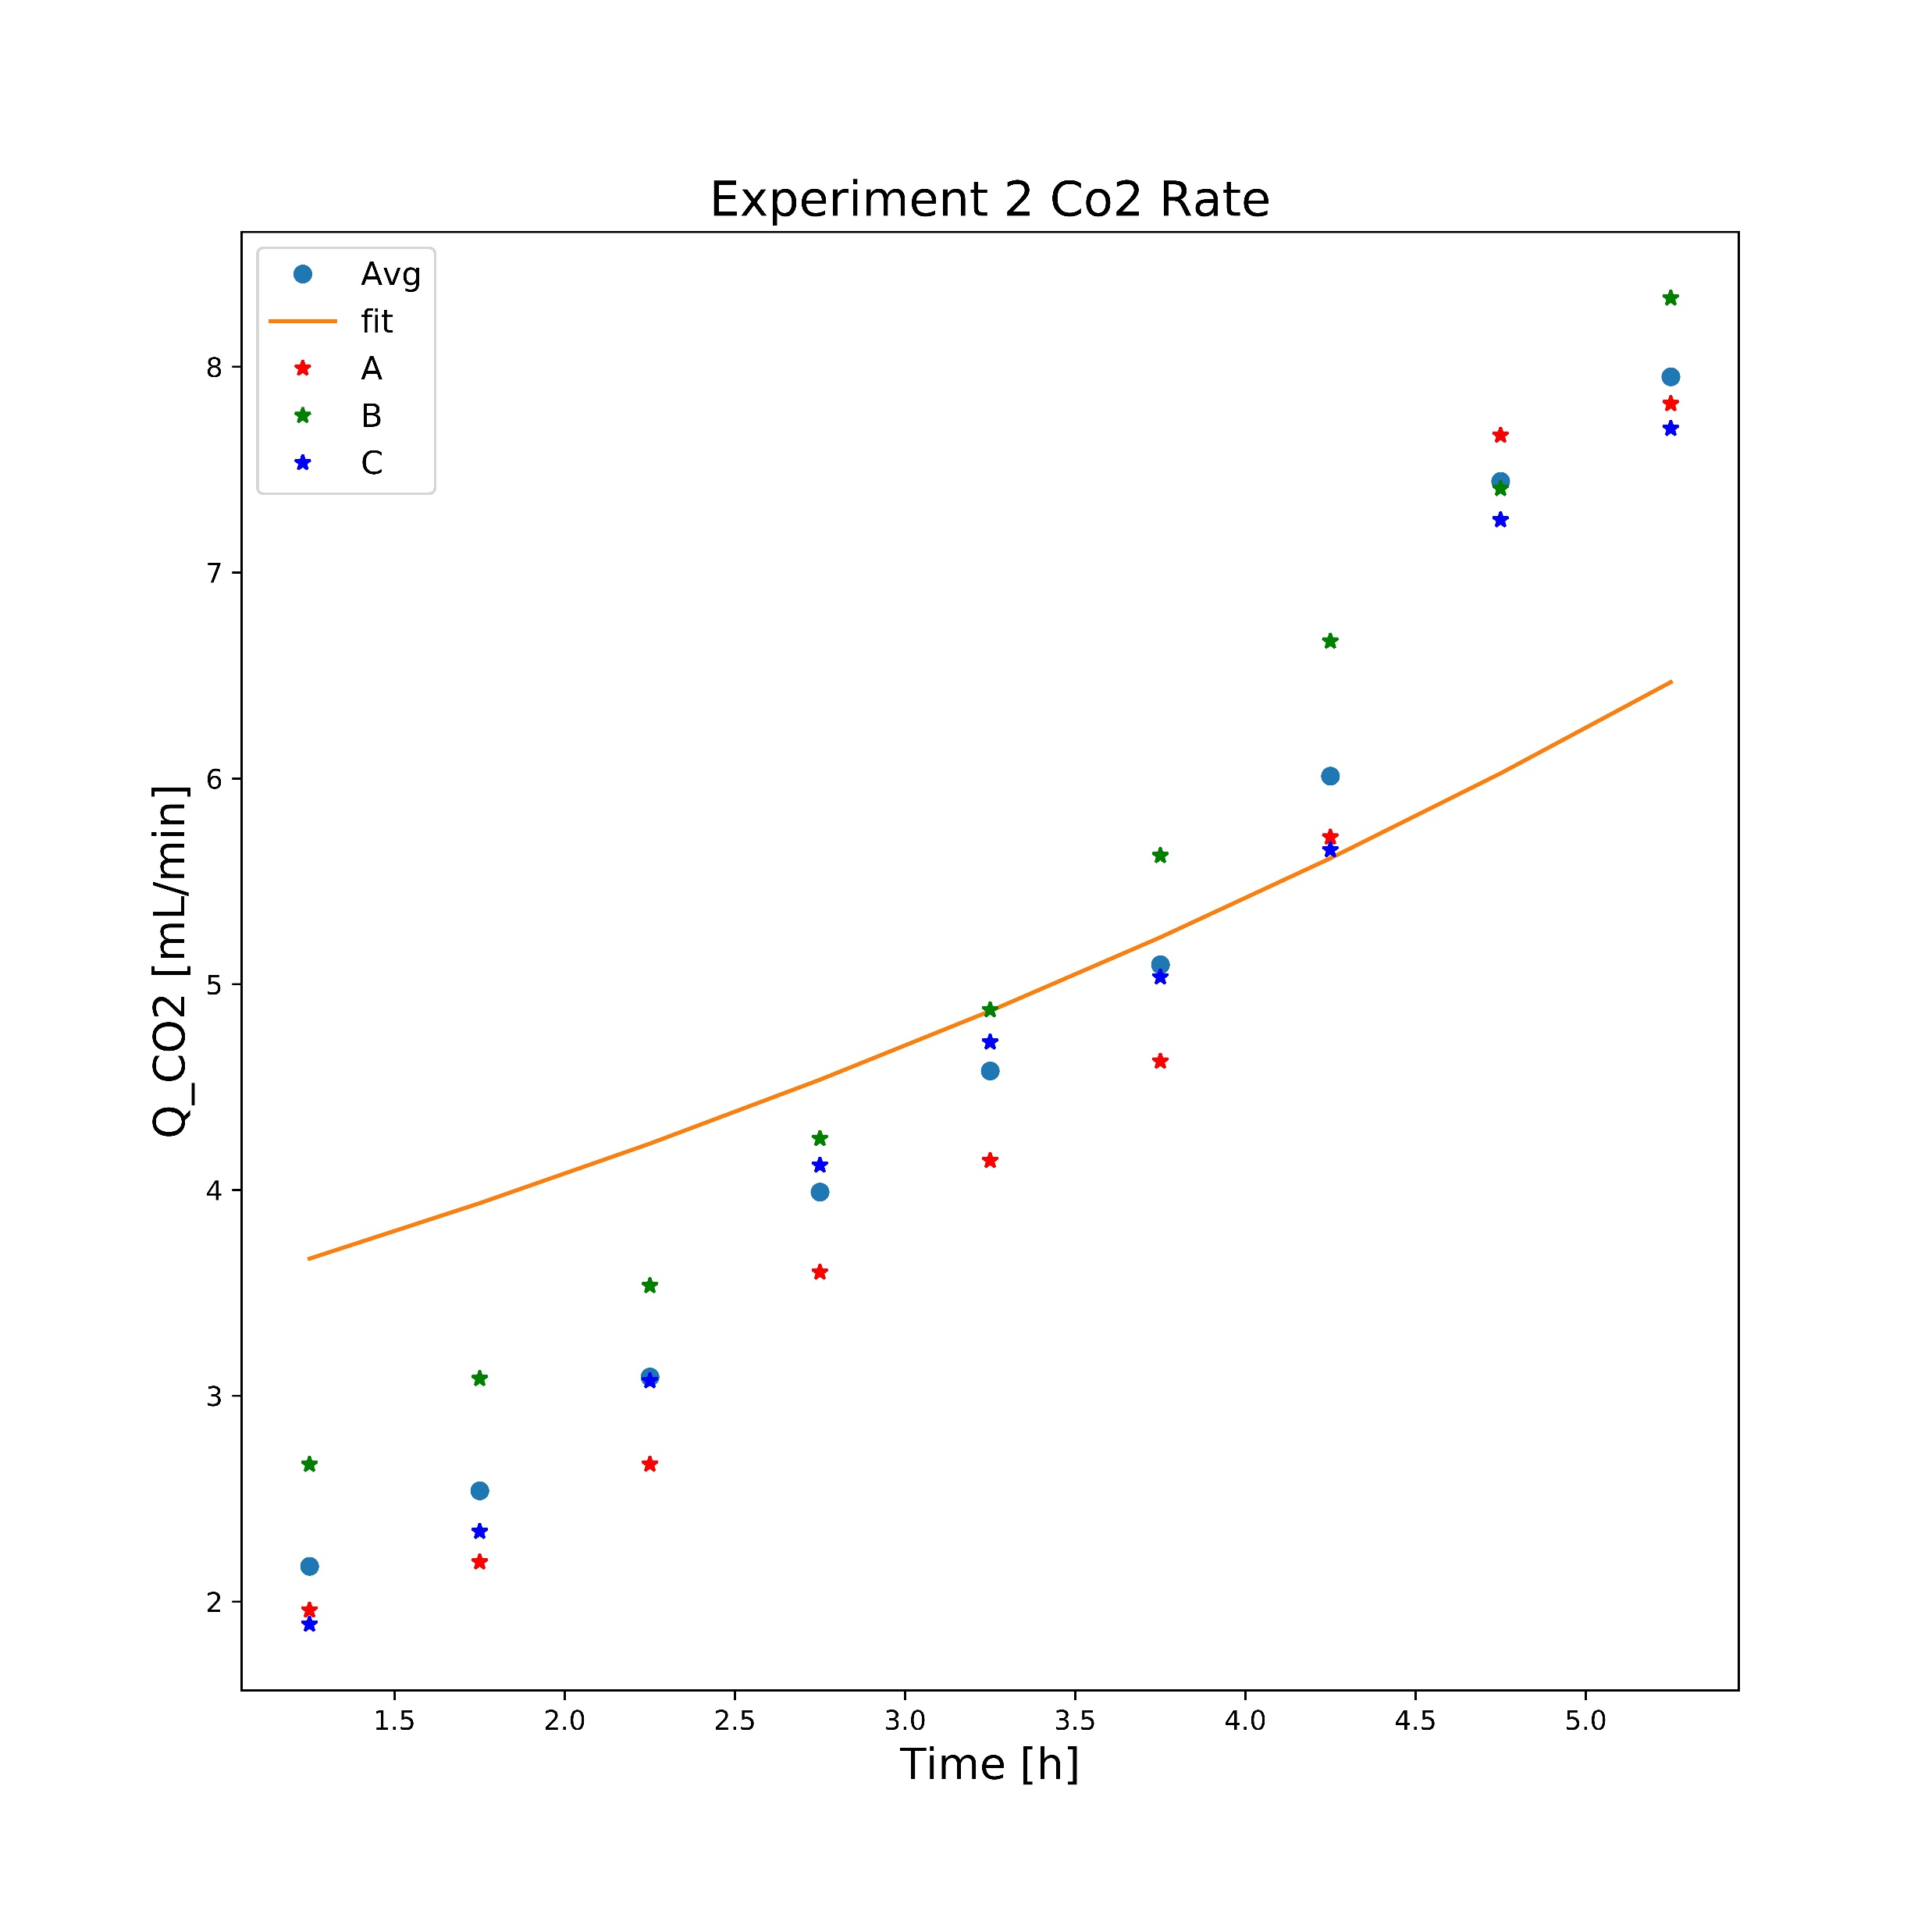
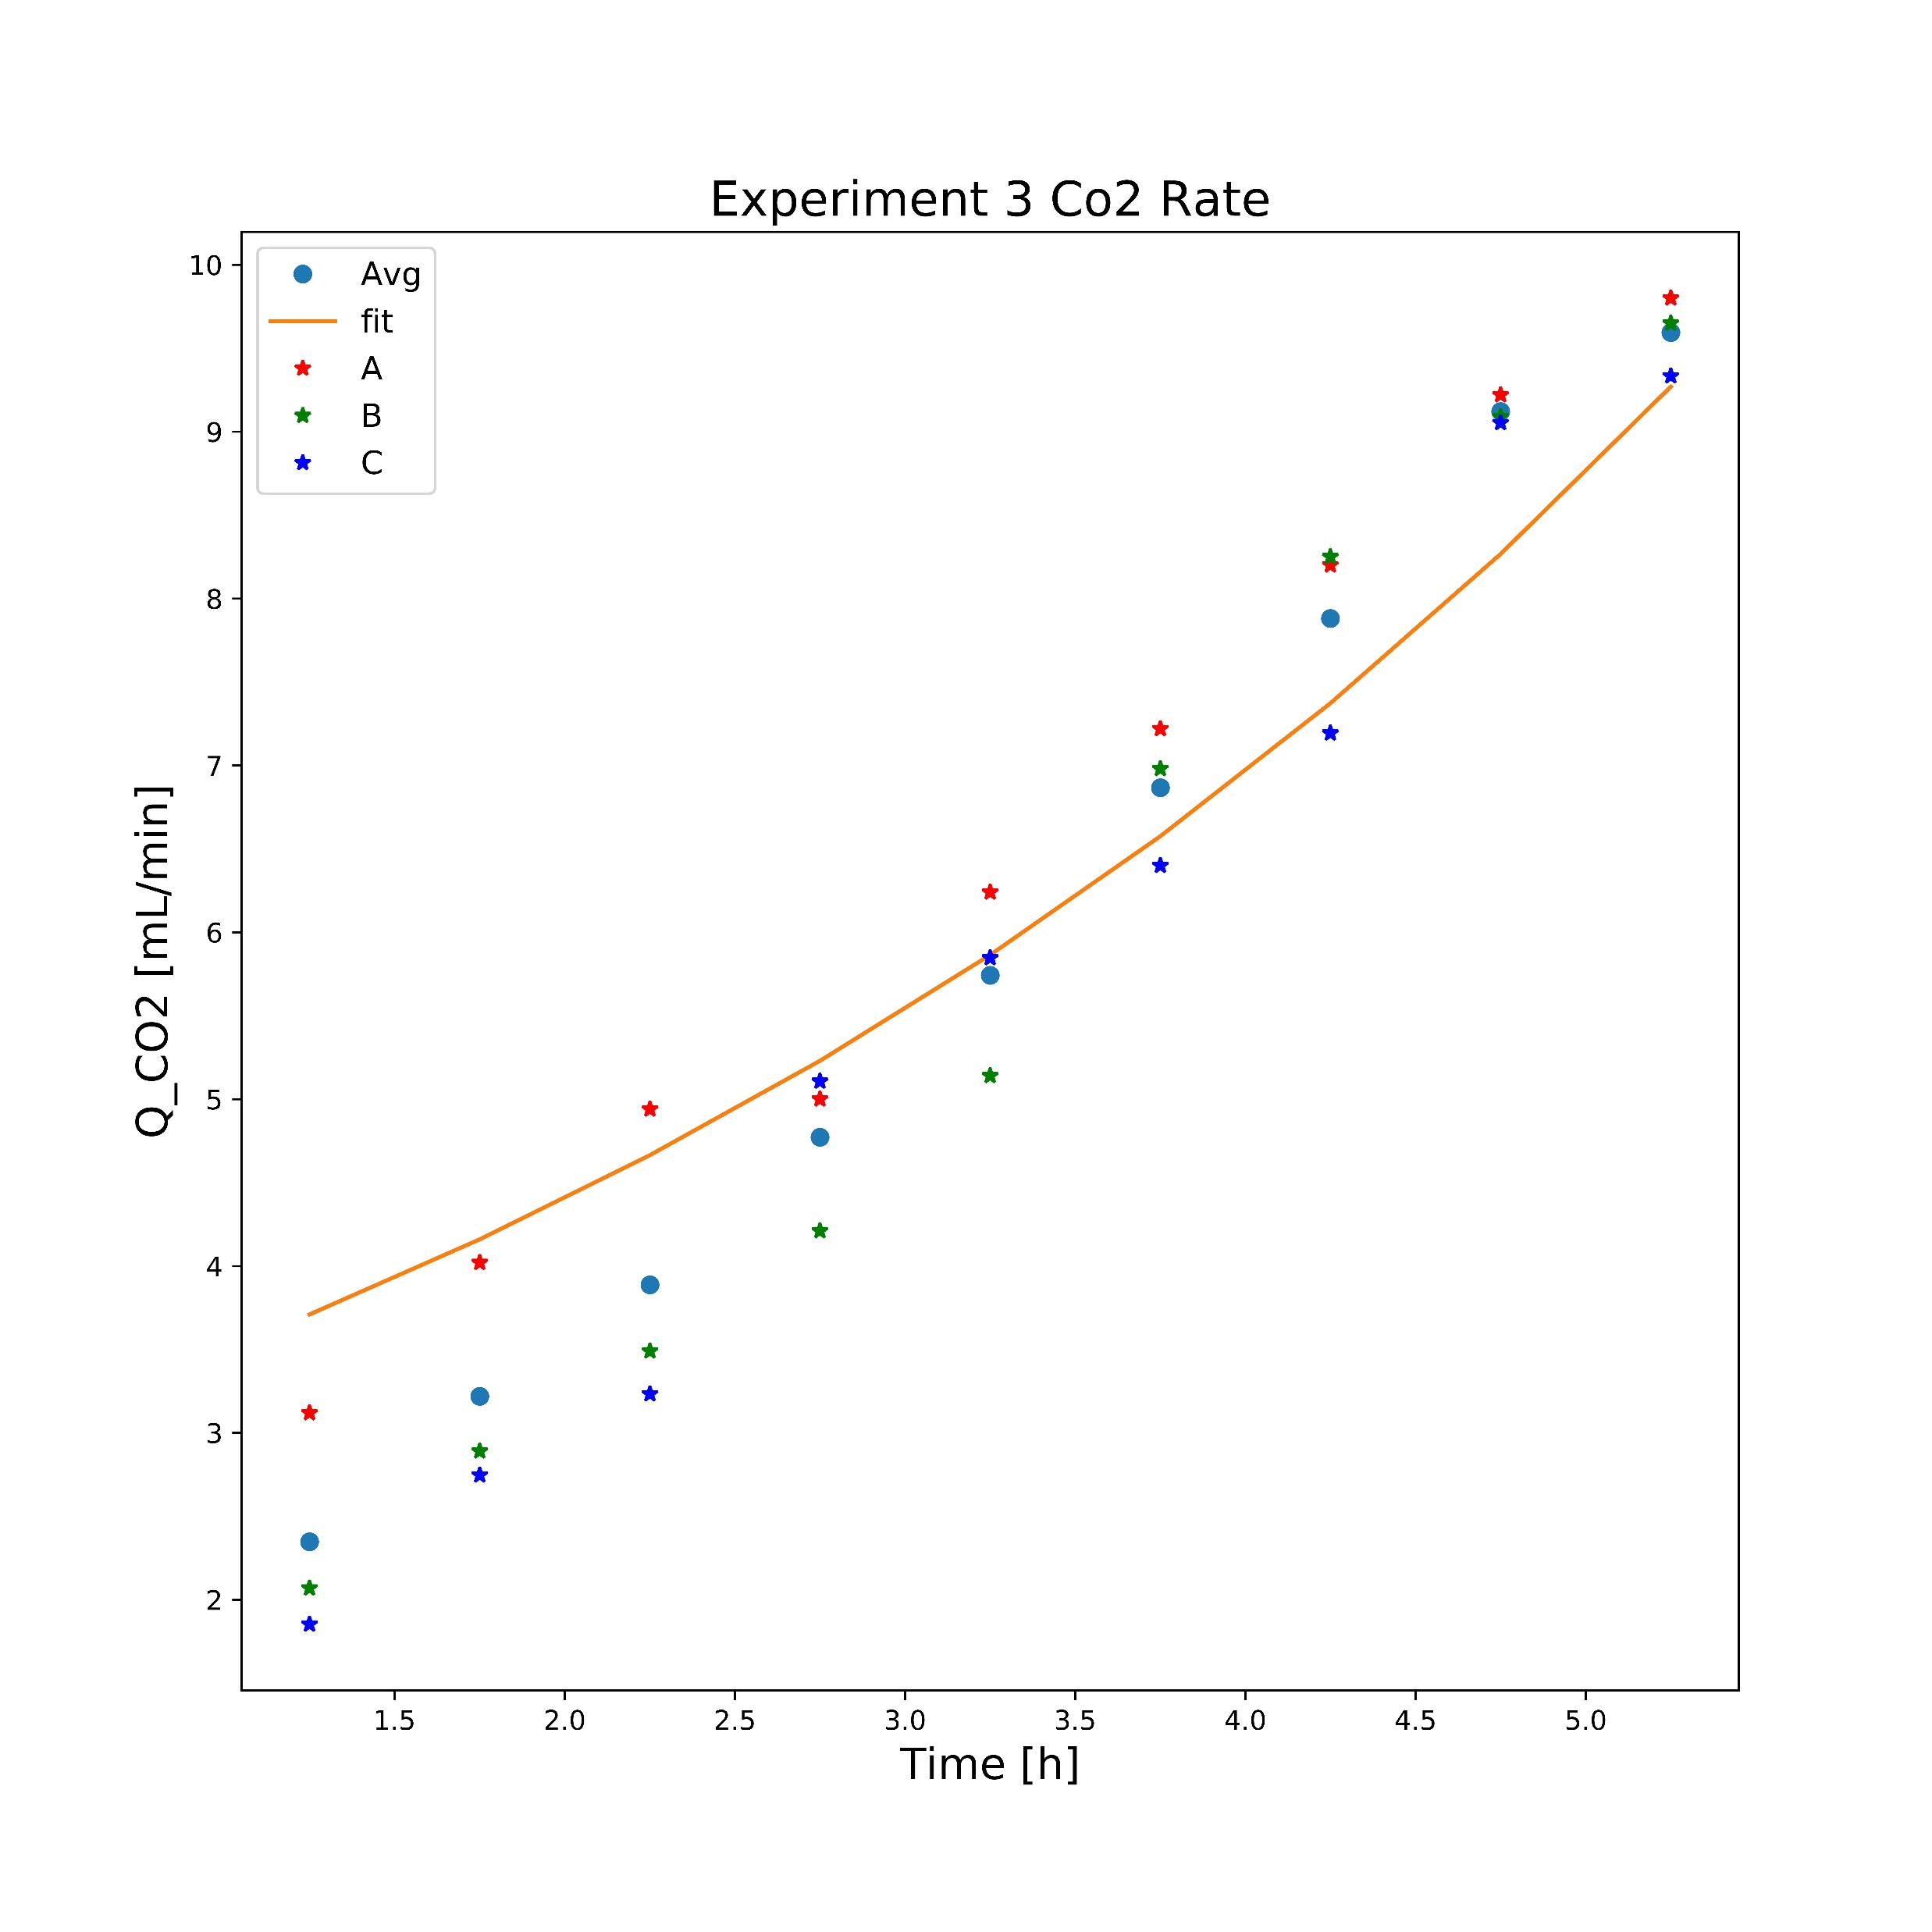
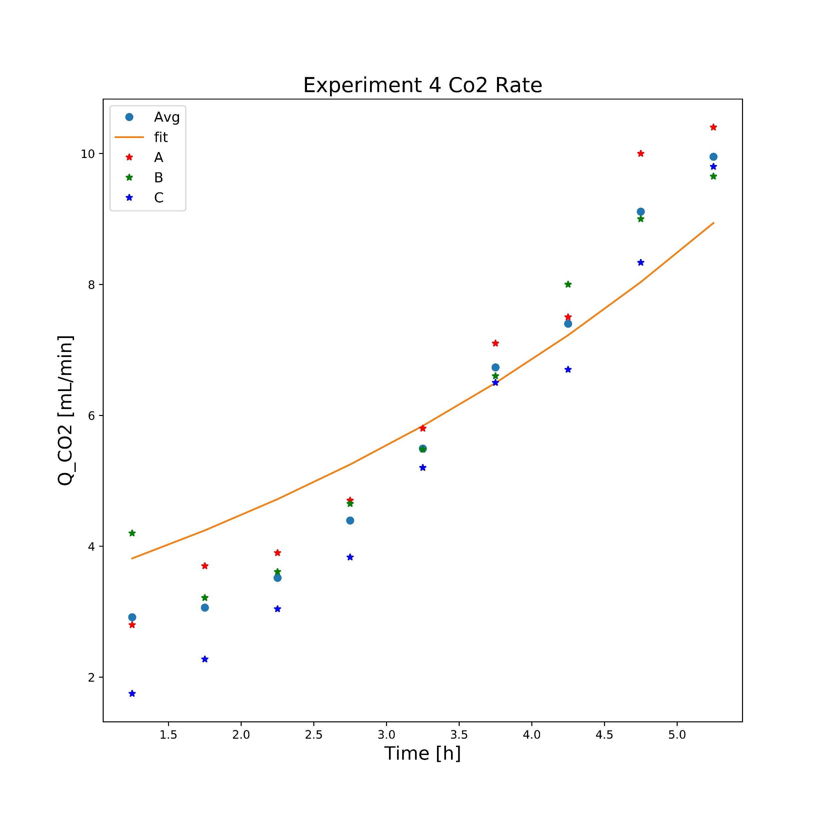
A4
γ For Average
RCO₂: 1,381
γ For Average
RCO₂: 1,273
γ For Average
RCO₂: 1,212
γ For Average
RCO₂: 1,052
γ For A4
RCO₂: 1,11

Slide 3
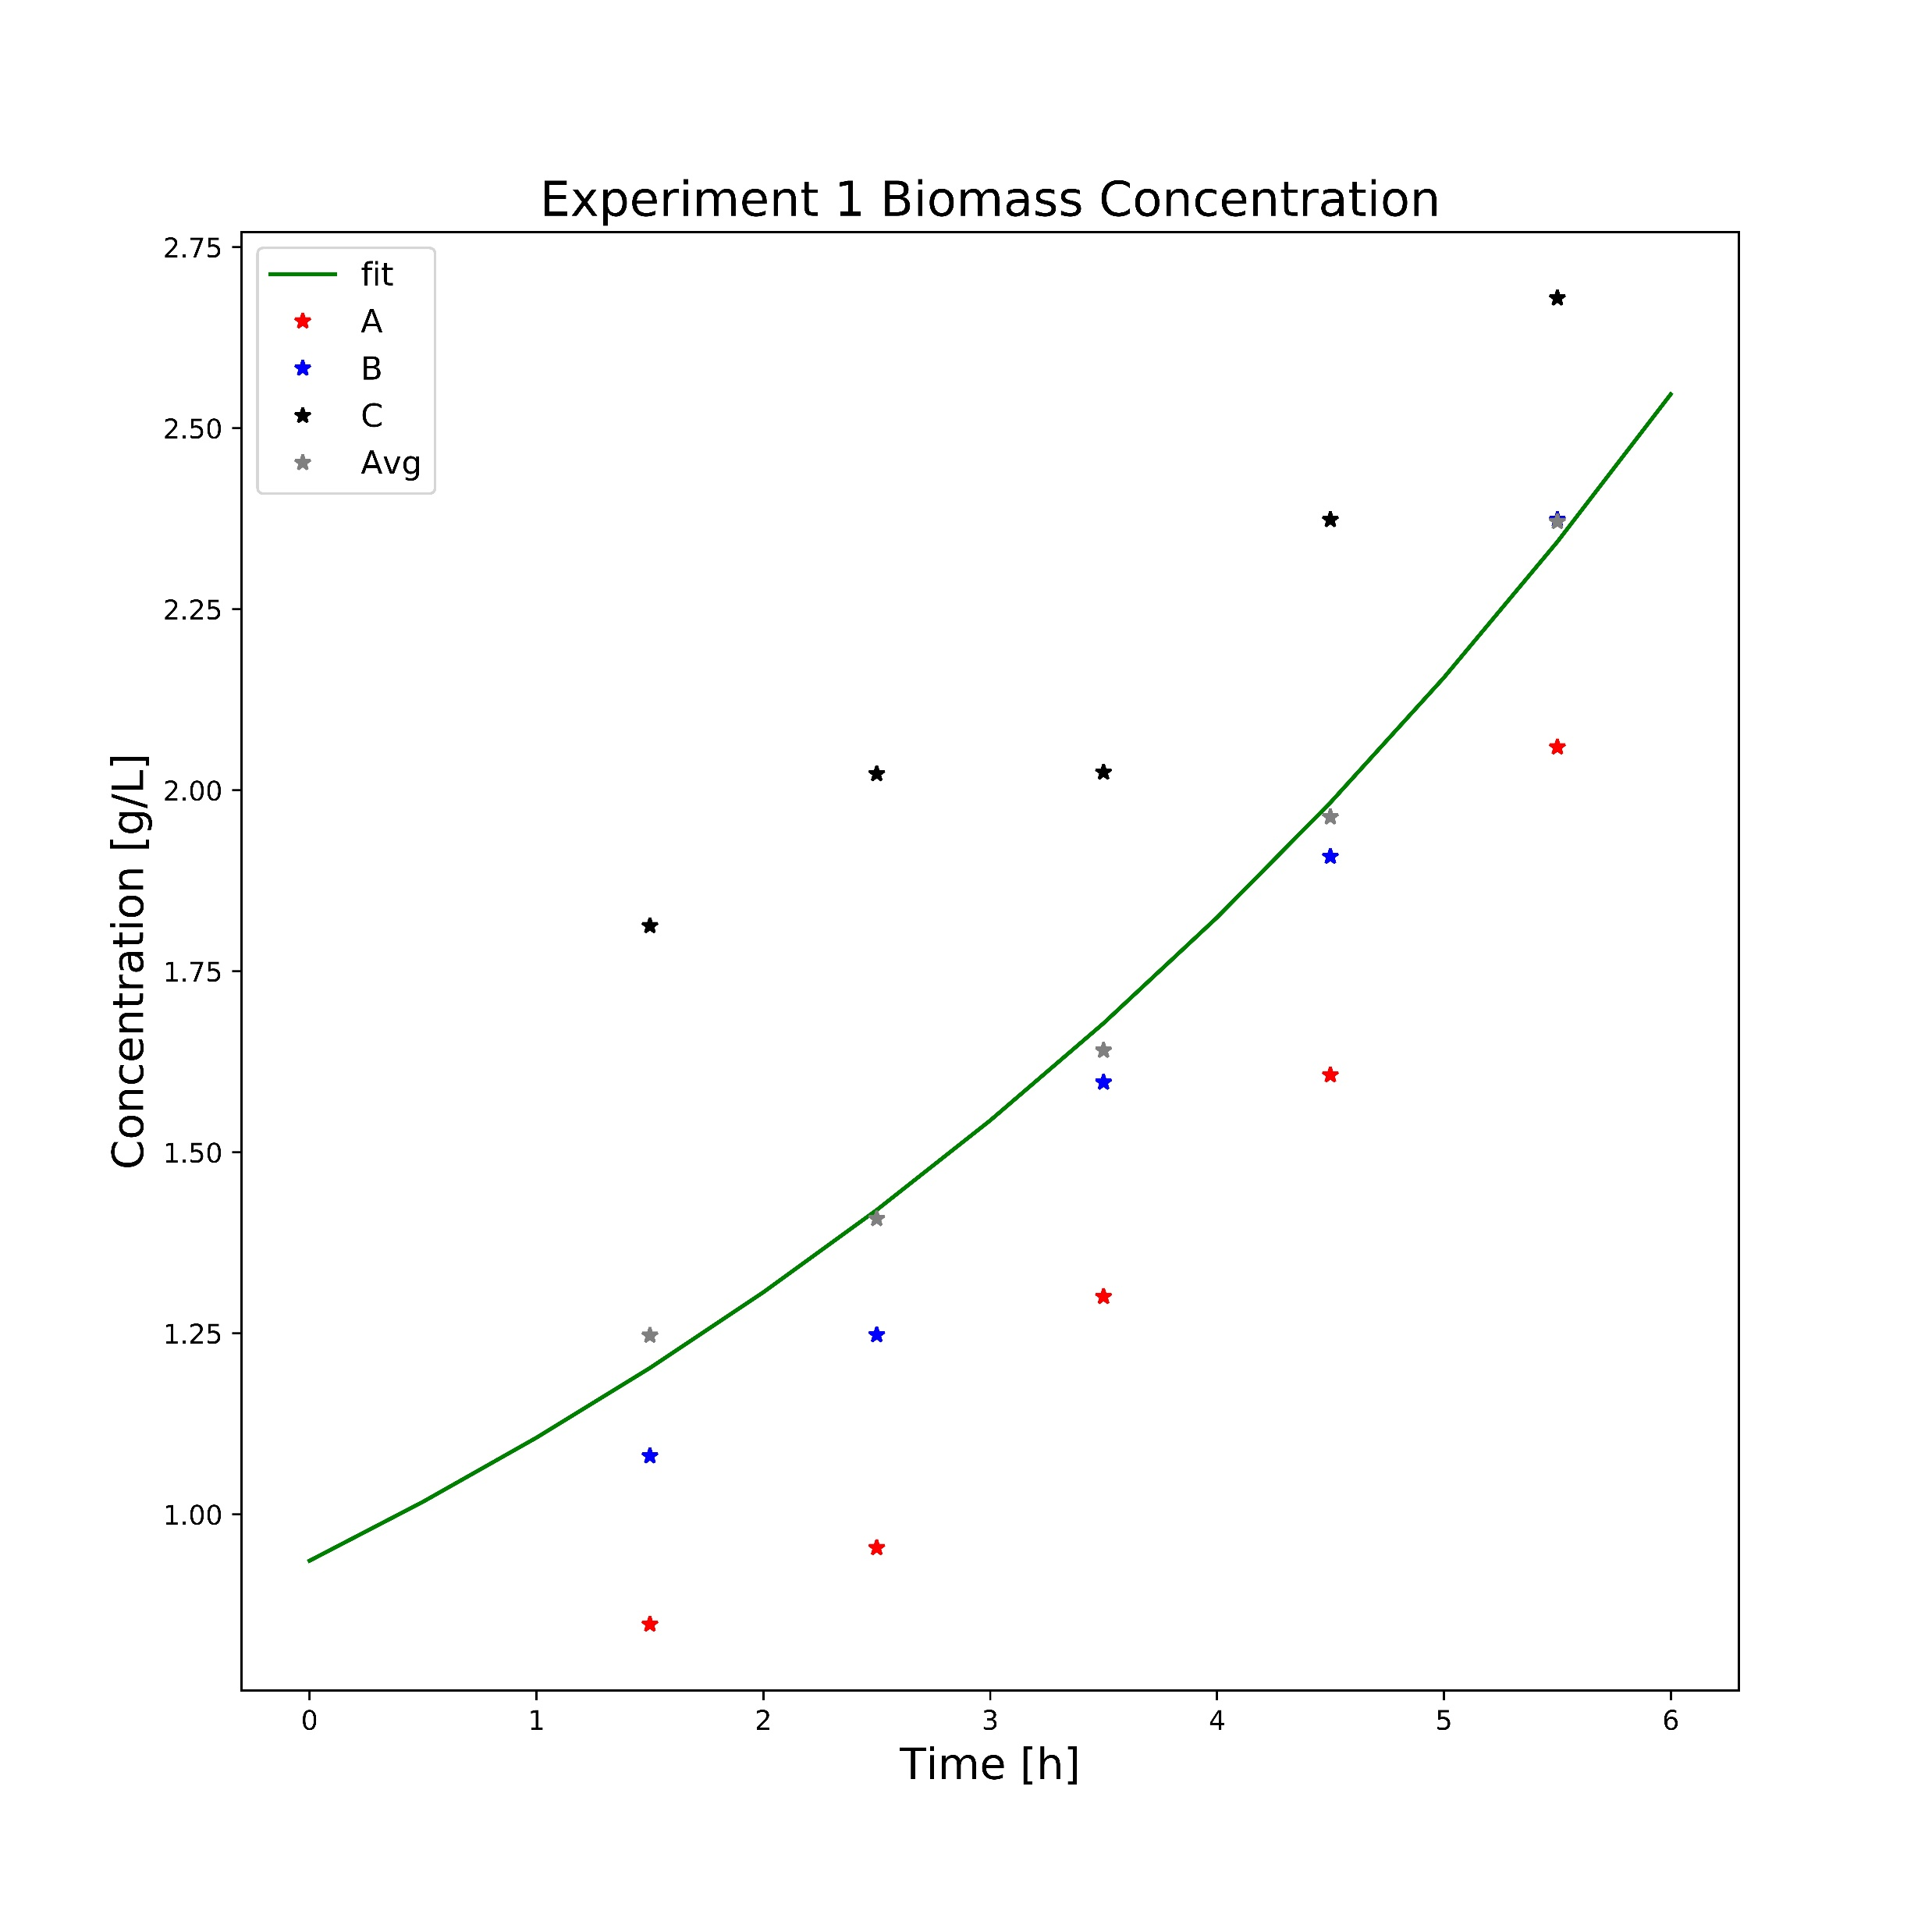
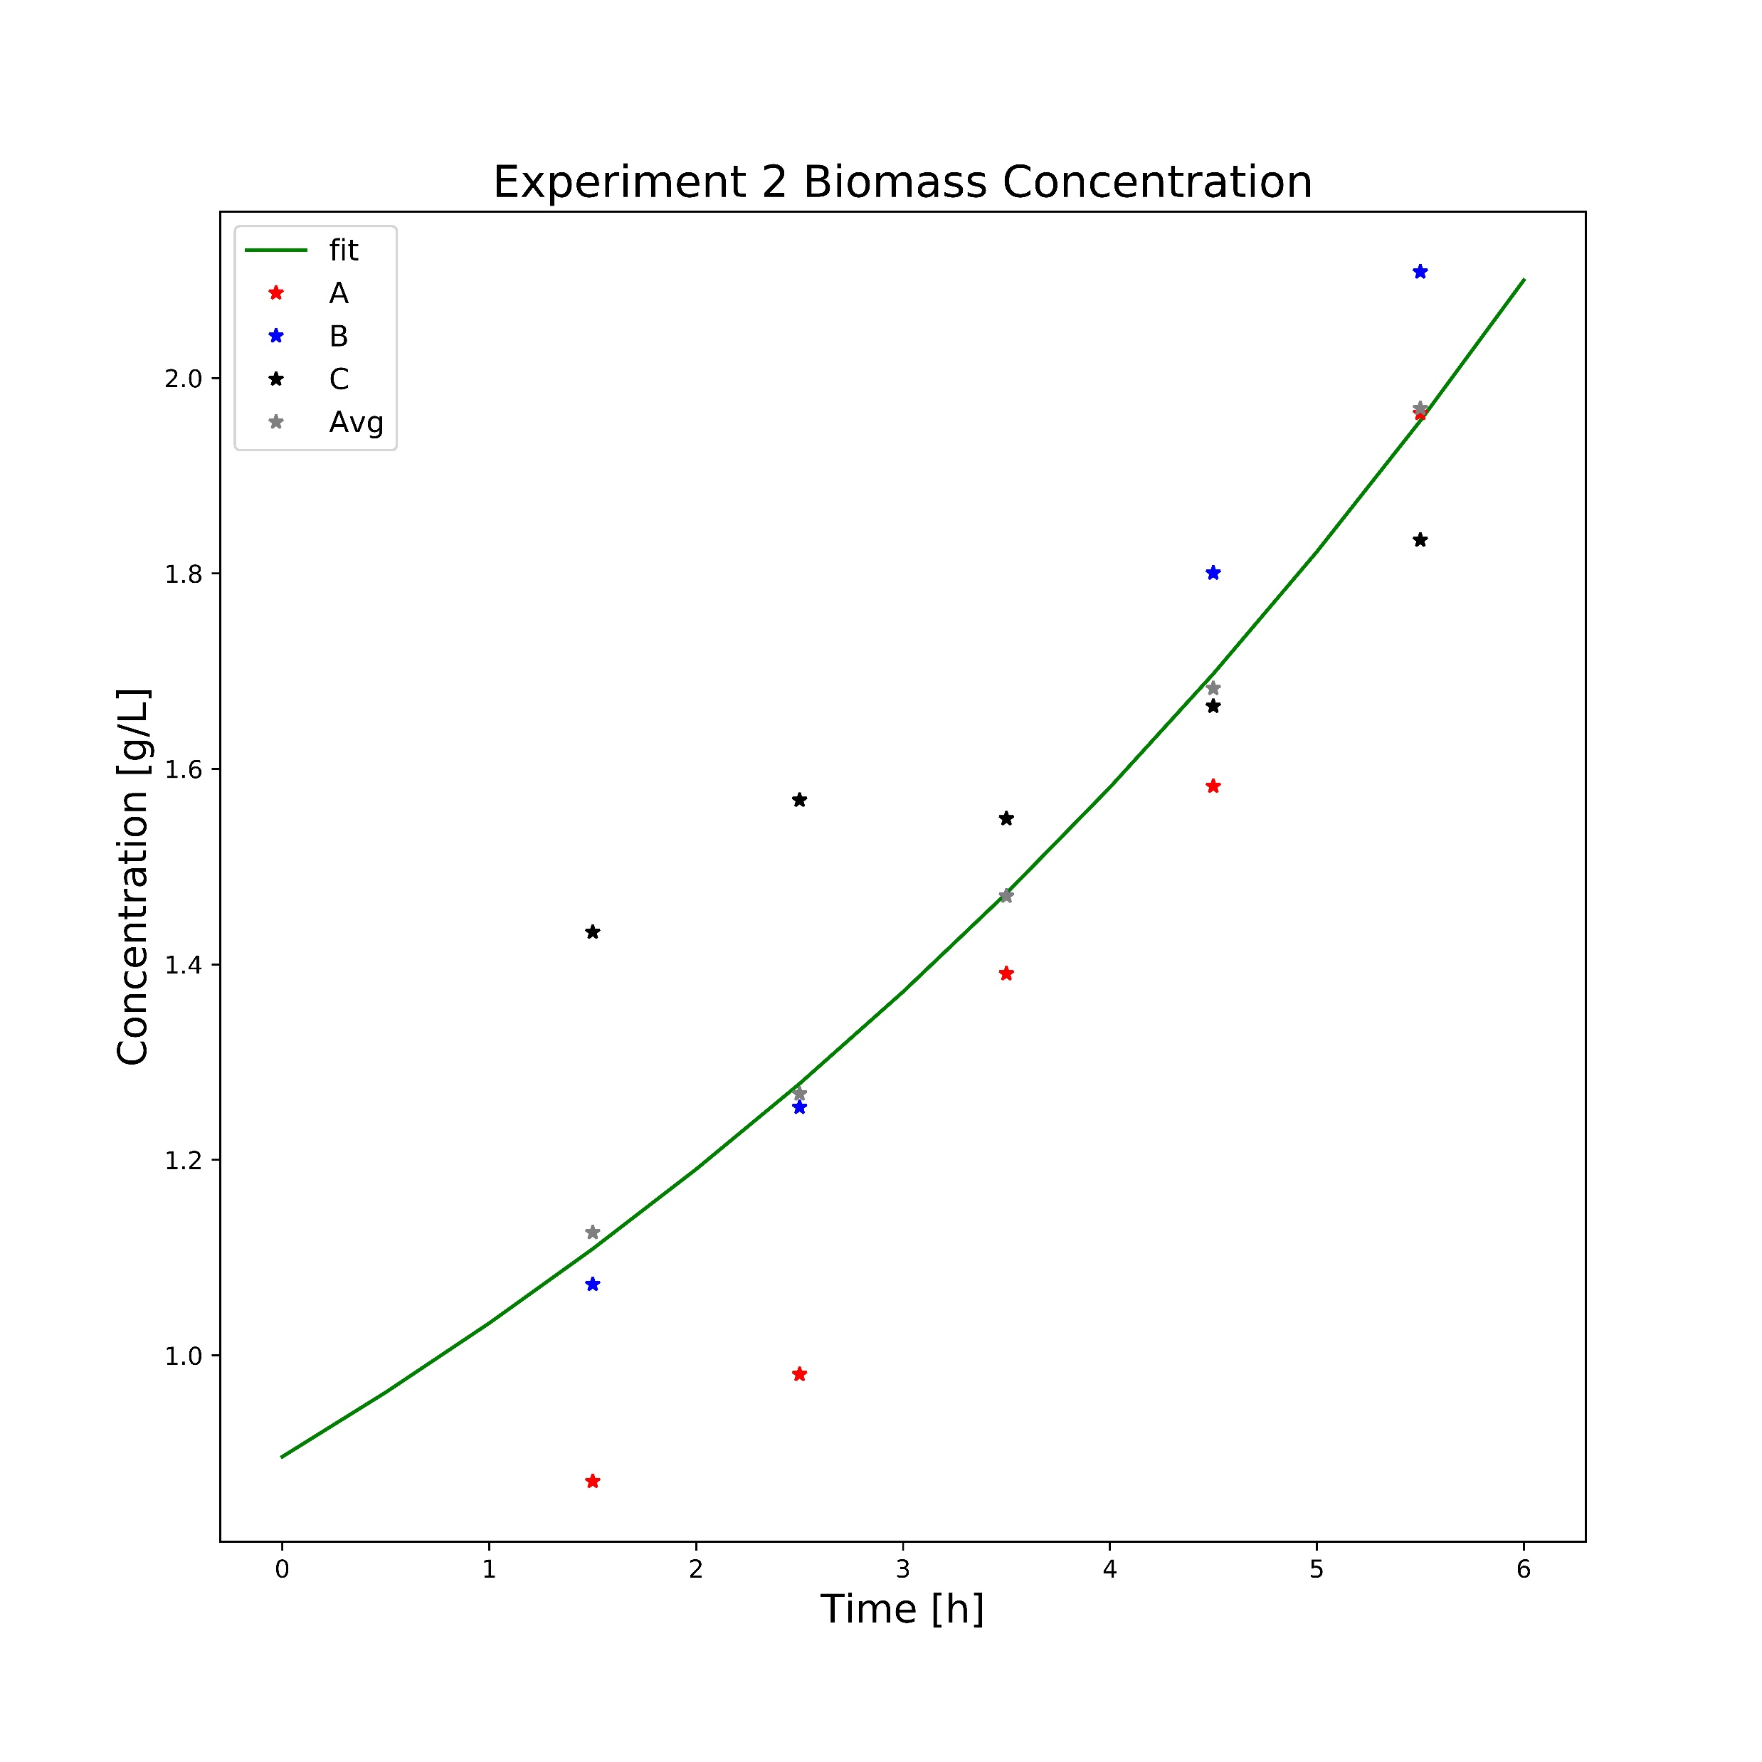
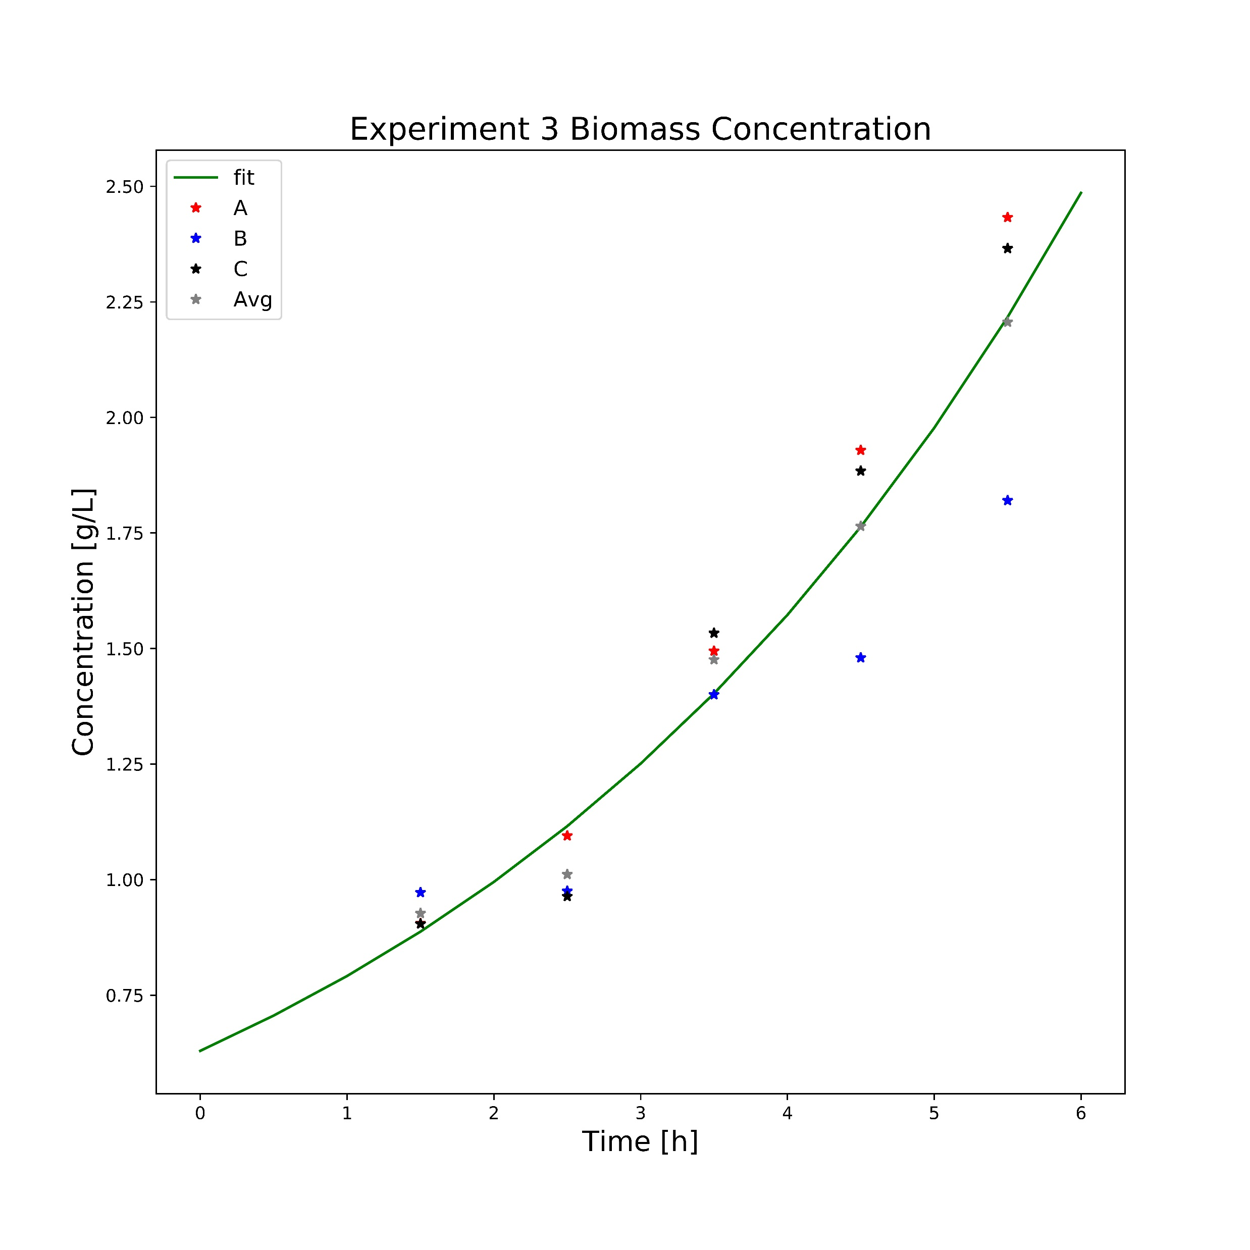
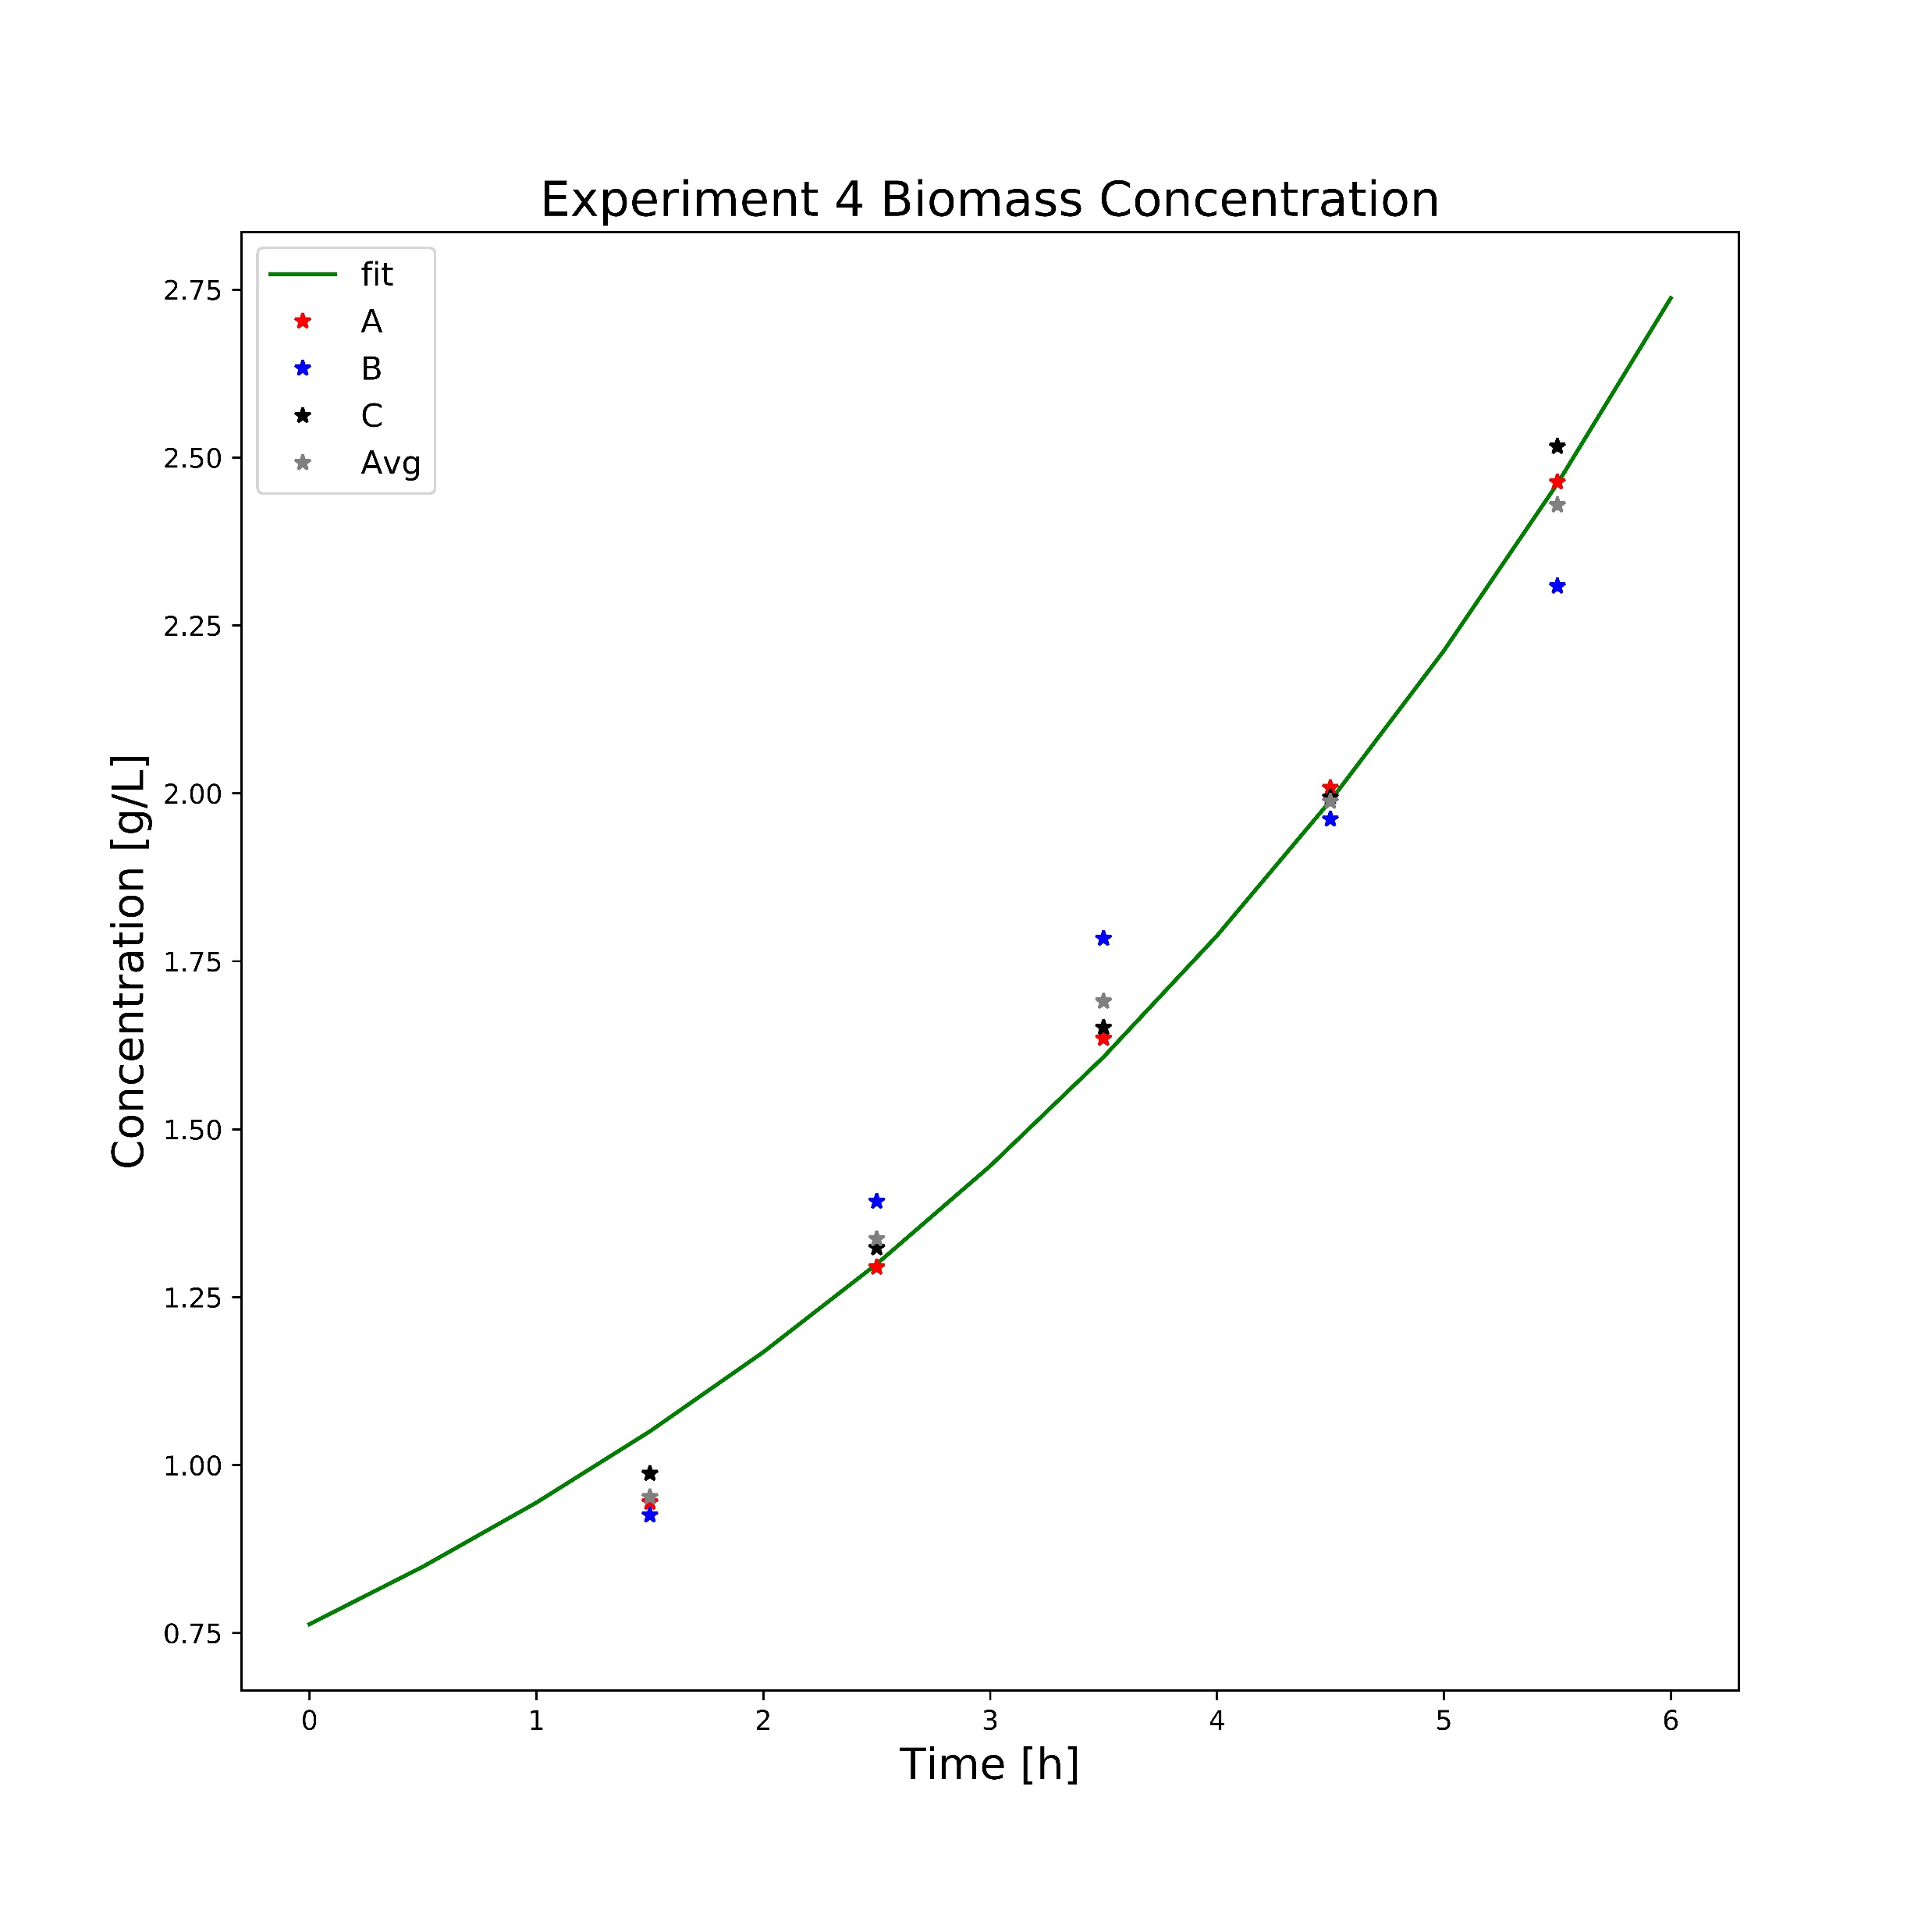
A4

